Slide 1

Key Population clients:
our needs matter when getting
us into services
(transgender women/TGW)
Alícia Krüger, BPharm, MPH.
Ministry of Health of Brazil
Health Surveillance Secretariat
Departament of Surveillance, Prevention and Control of STIs,
HIV / AIDS and Viral Hepatitis
Notes:
Good afternoon everyone. My name is Alícia Krüger, I am pharmacist, and I work at the Department of STIs, HIV/AIDS and Viral Hepatitis of Ministry of Health of Brazil, on HIV Combination Prevention Actions focused on transpeople, cisgender women and youth. I am also the current president of the Brazilian Professional Association for Transgender Health (BRPATH) – the Brazilian Chapter of the World Professional Association for Transgender Health (WPATH). I would like to begin my speech by thanking IAS and other partners for allowing me to be part of such an important session.

Slide 2
Disclosure
I have no conflict of interest to declare

Slide 3

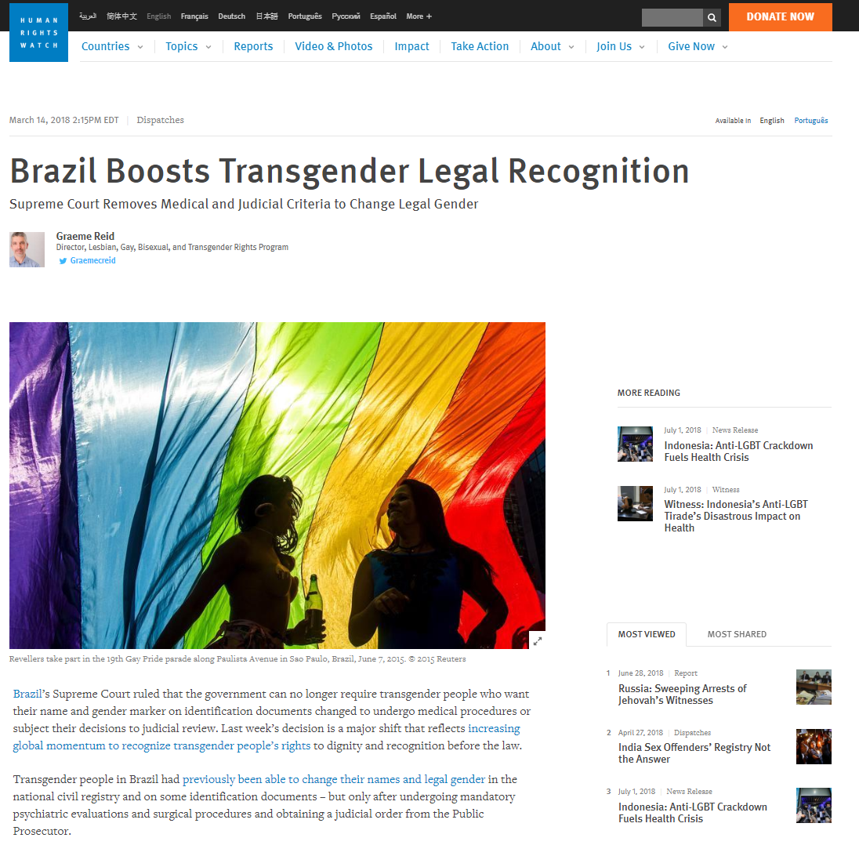
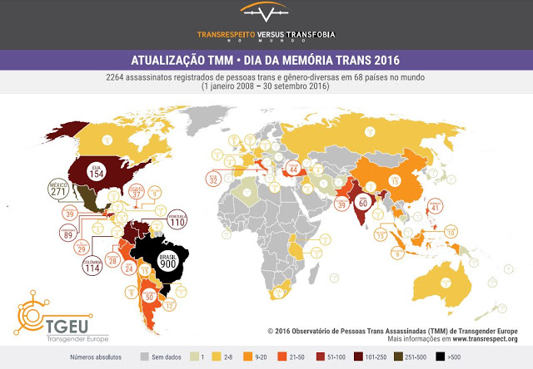

A paradoxal scenario in Brazil
In Brazil, transpeople are allowed to change their name and gender in official documents without medical evaluations or judicial decisions (Supreme Court decision)
Worldwide, Brazil is the country that most murders transpeople (TGEU, 2016)
2018
Brazil’s Supreme Electoral Court allowed trans people to use social names in their electoral identity cards and apply to be candidates in elections according to their current gender (gender political party quota)
Notes:
So, I would like to start by talking about Brazil’s legal environment concerning transpeople. I am happy to say that Brazil is one of the few countries worldwide to allow transgender people to change their names and gender in official documents without needing medical evaluations or judicial decisions, thanks to a Supreme Court decision. Moreover, Brazil’s Supreme Electoral Court has also decided that transgender persons can apply for election according to their gender identity (gender political party quota). Otherwise, unfortunately, not everything is good news. Brazil is the country that most murders transpeople in the world, according to TGEU’s data in 2016.

Slide 4

Brazilian National Policy for the Comprehensive Health
of LGBT Persons
(established by law)
Brazil’s Unified Health System (SUS) establishes and pays for sex reassignment surgeries universally and free of charge (in 11 authorized services)
Includes harm reduction actions for transpeople
Its National Policy for the Integral Health of LGBT Persons improves transpeople’s access to STI, HIV / AIDS and viral hepatitis services
SUS establishes and pays for hormones universally and free of charge
Also establishes the use of social name in healthcare records
Establishes the sexual and reproductive rights of transpeople
Notes:
Talking about health, in Brazil there is a National Policy for the Comprehensive Health of LGBT Persons established by law. It offers transgender people procedures such as hormones and surgeries free of charge and it establishes respect and gender recognition for all within healthcare services.

Slide 5
HIV prevalence, Brazil, 2002-17
Pesquisa DIVAS: first RDS on transwomen data (n=2864)
Notes:
Brazil monitors its concentrated HIV epidemic among specific key populations. These data show that transgender women are the most affected by HIV, highlighting the great and multisectoral challenge that Brazil faces in offering this population access to health and other public policies. This data were collected by Pesquisa DIVAS RDS study - the first national KAP and serological study on transwomen in Brazil.

Slide 6

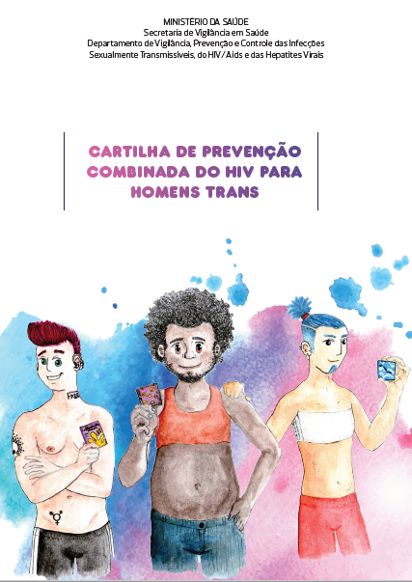


POPTRANS AGENDA, MoH Brazil
Trans data visibility within our systems
Live-Better-Knowing
First national booklet concerning the health of transmen
WEBDOC POPTRANS
PrEP for transwomen and transmen!
Notes:
To change the STI panorama in Brazil, the Ministry of Health has implemented a number of actions focused on transgender people. This POPTRANS AGENDA included, for example, Brazil’s first booklet on the specific health of transmen; two webdocs on transwomen and transmen health; making PrEP available to transpeople free of charge; peer testing and education, that is, transpeople test and share information with each other; and strengthening strategic information by collecting specific data on transpeople from our systems. The system’s fields are synergic. If a person doesn’t have a social name anymore (in case of civil change), the system captures gender identity, genital organ at birth and sexual orientation. This synergy provides more robust data. Within the MoH, this agenda is led by a healthcare professional who is also a transgender woman: ME! Next, I would like to highlight our major innovations: PrEP and the Live-Better-Knowing Strategy.

Slide 7
HIV tests performed (N and %), testing for the first time in life (%), and reagents (%) according to key population,
2014-2018
Key Population | Frequency | % of the population | % First test in life | % reagents
Cisgender women | 70.973 | 44,1% | 47,3% | 0,7%
Cisgender heterossexual men | 48.243 | 30,0% | 63,7% | 0,9%
Cisgender gay and another MSM | 33.779 | 21,0% | 45,0% | 3,3%
Transgender persons | 7.773 | 4,8% | 38,1% | 6,1%
Total | 160.280 | 100,0% | 51,3% | 1,6%
Notes:
Brazilian Ministry of Health developed a strategy called Viva Melhor Sabendo (“live better knowing”) to increase HIV testing among key populations. In partnership with nongovernmental organizations (NGOs), a peer point-of-care testing intervention, using an oral fluid rapid test, was introduced at social venues for key populations at different times of the day. According to its data, although transpeople presented the lowest numbers of persons tested, thirty-eight percent of them had never been tested before. And it’s also important to highlight that this population reached the highest HIV prevalence rate (six per cent of the total).

Slide 8
Profile of PrEP users
(Jan-Jun, 2018)
Earlier adopters
Notes:
Concerning PrEP, this is a graph of the general profile of PrEP users in Brazil within its Unified Health System. Altogether, two thousand seven hundred and thirty-five persons are on PrEP in Brazil. This graph shows that most of them are cisgender, gay men. Neither transgender women or men have had much access to this important prevention technology. Among the sixty-nine trans persons (women and men, according to the graph) who did, most of them were white, young and had more schooling. That’s because trans people in Brazil and worldwide face a lot of prejudice and discrimination, resulting in lack of schooling, of employment, of civil and social rights and, consequently, of access to health. To link more trans people to PrEP, we must address the structural barriers that are part of this framework, and then fight to create a positive environment for these people (earlier adopters).

Slide 9

Steps to Improve HIV Prevention and Care*
Hormone therapy is a trand person’s first motivation to seek healthcare services
Thus:
HIV services and hormonal care should be integrated
Health professionals should be trained to manage hormone therapy
A safety assessment of hormone use and HAART should also be carried out
(this is valid for PrEP as well!)
Trans health campaigns should be made with real trans persons
Trans workers should be hired!!!
https://www1.nyc.gov/assets/doh/downloads/pdf/ah/transgender-womens-health-booklet.pdf
LINKAGE!
Hormone therapy
HAART/PEP/PrEP
Hormone therapy
+ HAART
*Sevelius, J. Ann Behav Med. 2014 February ; 47(1): 5–16
*Sevelius J, et al. J Assoc Nurses AIDS Care. 2010 ; 21(3): 256–264
*Sevelius J, et al. AIDS Care. 2014 August ; 26(8): 976–982
*Deutsch M, et al. 2015 NHPC.
Notes:
So, taking these data into account, and aware that trans people’s first motivation when seeking healthcare services is hormone therapy – and if we really want to fight the HIV epidemic among this population (which have the highest prevalences) – we should integrate HIV services and hormonal care, training health professionals to manage hormone therapy, make safety assessment of hormone use and HAART (this is also valid for PrEP!). Brazil is integrating PrEP services and transgender-specific healthcare services (there are 11 in Brazil) to work together and in one unique flow. It’s also important to carry out trans health campaigns with real trans persons, and… to hire trans workers!!!

Slide 10

Brazil’s National Transgender Visibility Day
In 2004, the Brazilian Ministry of Health’s Department of STIs, HIV/AIDS and Viral Hepatitis supported the creation of the Brazil’s National Transgender Visibility Day – January 29th – through campaign “Travesti e respeito” (Transwomen and respect).
Notes:
The Brazilian Ministry of Health’s Department of STIs, HIV/AIDS and Viral Hepatitis officially established Brazil’s National Transgender Visibility Day – January twenty-nine – through campaign “Travesti e respeito” (Transwomen and respect). The date is now celebrated annually.

Slide 11
Conclusions
Positive legal scenarios for transgender people improve their linkage to health services. Social determinants are fundamental to health;
Established LGBT National Health Policies may favor transgender people’s access to health services, and the opposite is also true;
Involving transgender people in actions to fight the HIV epidemic and other STIs is crucial (such as in peer-to-peer actions and technical decision-making committees);

Slide 12
Conclusions
Positive legal scenarios for transgender people improve their linkage to health services. Social determinants are fundamental to health;
Established LGBT National Health Policies may favor transgender people’s access to health services, and the opposite is also true;
Involving transgender people in actions to fight the HIV epidemic and other STIs is crucial (such as in peer-to-peer actions and technical decision-making committees);
And...

Slide 13

Conclusions
Hiring trans people makes health services
friendlier!!!

Slide 14

Thank you!
www.aids.gov.br
www.saude.gov.br

